Slide 1


Attention is all you need
by :
Rahaf Habaybeh 021900
Leelya Khodier 0216229
Beesan Al attal 0214632
Dana Othman 0211228
Dania Abu Zidan 0216910
supervised by : Dr.Zeina Youssef

Slide 2

Introduction
Recurrent Neural Networks (RNNs), including advanced types like LSTM and GRU, have been foundational in sequence tasks like language modeling and translation. However, their sequential nature limits parallel processing, slowing training on longer sequences. To overcome this, attention mechanisms emerged, enabling models to capture relationships in sequences more flexibly.
Building on this, the Transformer model uses only attention mechanisms, achieving faster and more efficient processing with improved translation quality, setting a new standard in sequence modeling.

Slide 3

The Transformer Model in Sequence Processing :
such as language translation.
Limitations of Traditional Models :
This approach requires more training time, especially when dealing with longer sequences.
The Power of Attention Mechanisms :
This innovation enables it to process data on multiple processors at once, making it faster than traditional models.

Slide 4

Superior Translation Quality :
In translation tests, the Transformer has shown an ability to deliver high-quality
translations with reduced training time
Flexibility in Other Tasks :
Beyond translation, the Transformer model has proven versatile in tasks
like English sentence parsing.
Significance in AI :
This innovation paves the way for faster, more accurate language models.
such as machine translation and text analysis.

Slide 5

Background
Understanding the Background of Transformer Models :
Transformers revolutionized sequence modeling by removing reliance on RNNs and convolutions.
Built entirely on self-attention for input/output representation.

Slide 6

Sequential Computation Challenges
Traditional models (Extended Neural GPU, ByteNet, ConvS2S) rely on convolutions for parallel computation.
Challenges:
ConvS2S: Linear operation growth with distance.
ByteNet: Logarithmic operation growth with distance.
Makes learning long-distance dependencies harder.
Transformer Solution:
Constant operations regardless of distance.
Uses Multi-Head Attention to counter reduced resolution in averaging.

Slide 7


What is Self-Attention?
Also called intra-attention.
Relates different positions in a sequence to compute its representation.
Applications:
Reading comprehension
Textual entailment
Abstractive summarization
Task-independent sentence representations.

Slide 8

Advantages of the Transformer:
Unlike sequence-aligned RNNs or convolutions
Transformer uses only self-attention
Advantages over
ConvS2S & ByteNet: Handles long-distance dependencies efficiently
End-to-End Memory Networks: Avoids recurrent attention mechanisms
Efficiently computes representations in parallel for all positions

Slide 9
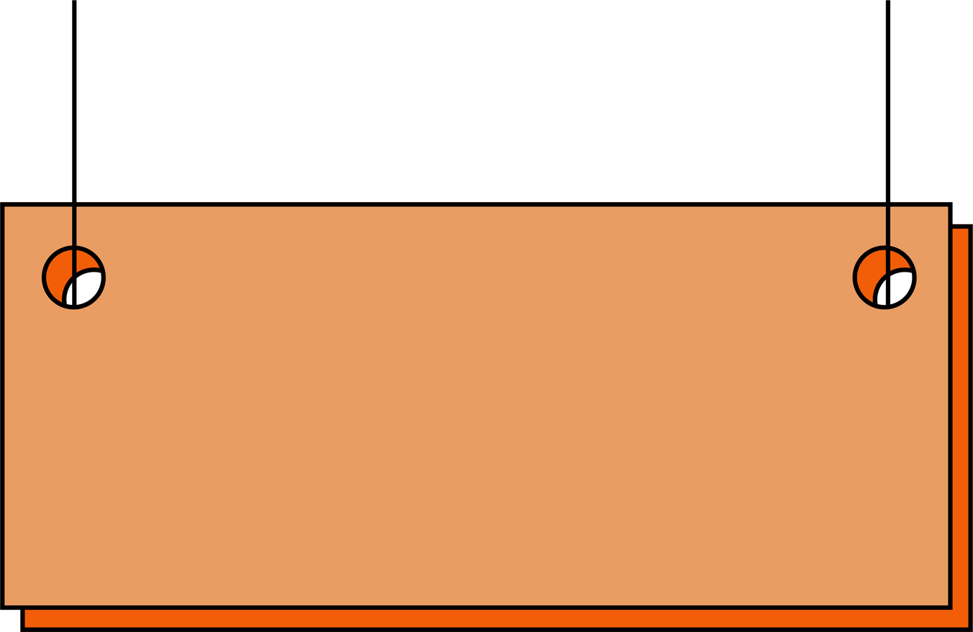
Why Transformers?
A groundbreaking approach that simplifies and accelerates sequence modeling.
Handles long-range dependencies with constant operations.
Widely adopted due to its flexibility and efficiency.

Slide 10

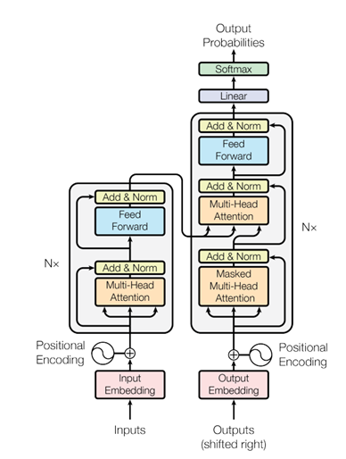
Model Architecture
Encoder-Decoder structure
Attention mechanism.
Positional embeddings.
Feed Forward Networks

Slide 11

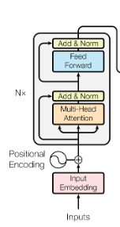


The Encoder:
Input embedding + positional encoding
Self-attention mechanism (global representation)
Feed-forward neural network (local representation, introducing non-linearity)
Add & Normalize layers (standardize and speed up the training)

Slide 12

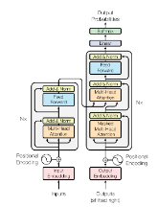

The Decoder:
Input embedding + positional encoding + offset the embeddings by one position instead of [‘I’, ‘Love’, ‘Cats’] [<Start>, ‘I’, ‘Love’, ‘Cats’]
Masked self-attention mechanism To ensure that the model does not see the future tokens (generate the next token given only the previous ones)
Encoder-decoder attention.
Feed-forward neural network.
Add Normalize layers.
that both the masked attention and the position offset of the output are to ensure that the model processes the sequence in an autoregressive manner, predicting one step at a time.

Slide 13

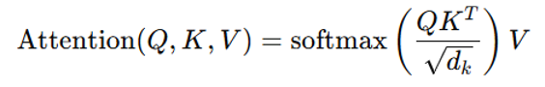
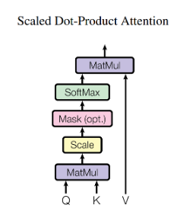
Scaled Dot-Product Attention
Attention Focuses on specific parts of the input sequence for each output.
Equation :
Diagram :

Slide 14

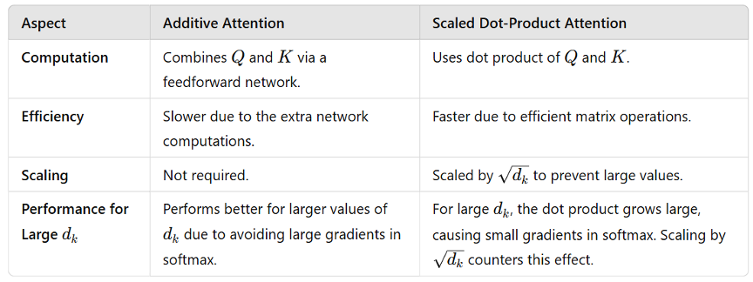
What is the point of scaling ?
Comparison between additive attention and scaled dot product attention :

Slide 15

Multi-Head Attention
(parallelism)
Definition: Extends attention mechanism to multiple subspaces.
Project Q, K, V into multiple heads map the vectors into a lower dimensional using a pre-trained matrix of weights
Apply scaled dot-product attention for each head.
Concatenate outputs and project back. (Go back to the original dimensionality of 512 vectors)
Why projection? (“Due to the reduced dimension of each head, the total computational cost is similar to that of single-head attention with full dimensionality”).

Slide 16


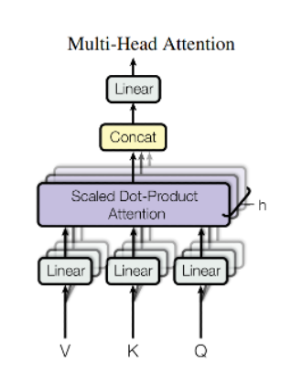

That the number of heads is considered a hyperparameter,
in the paper they used h = 8
In the Transformer model, d_model = 512 and h = 8 (number of attention heads)
That after concatenating the heads, we multiply the concatenation result with weights,
where each token has its own weight.

Slide 17
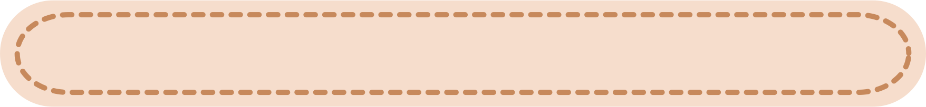
Applications in our model
The transformer uses multi –head Attention in three different ways :
1. Encoder Decoder Attention
2. The Encoder Attention
3. The Decoder Attention
The encoder-decoder Attention :
This allows the decoder to focus on relevant parts of the input sequence while generating output.
Example: If the input sentence is "I love cats," and the decoder is generating "أنا أحب القطط," the ".أحب" decoder can focus on "love" when predicting
The Encoder Attention :
Each position in the encoder attends to all other positions in the input to understand relationships.
Example: In "The cat sat on the mat," "sat" might attend to "cat" to capture that "the cat sat."

Slide 18

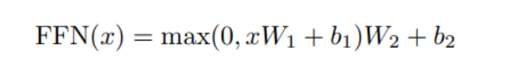

The Decoder Attention:
Each position in the decoder attends only to the positions before it (to preserve the sequence generation order).
Example: While translating "I love cats," when the decoder generates "أحب," it will consider ".القطط" but not "أنا"
Position-wise Feed Forward Networks
After attention, each word's representation is passed through a feed-forward network (FFN). This is like an extra layer of "thinking" applied independently to each word
How it Works:
Each word’s vector is transformed through two linear layers with a ReLU activation in
between
Why it Matters:
Attention looks at relationships between words, while FFN helps refine individual word meanings.

Slide 19
Embeddings And Softmax :
Embeddings:
Converts words into numerical vectors (e.g., "cat" → [0.1, 0.5, -0.3]) so the model can process them.
Words with similar meanings have similar vector representations, helping the model understand relationships
Softmax:
At the final step, converts the model's output into probabilities for each word in the vocabulary.
The word with the highest probability is selected as the next word in the sequence
Example:
For the sentence "I love cats":
Embedding turns "I," "love," and "cats" into vectors.
Softmax ensures the model generates "أنا أحب القطط" by assigning the highest probabilities
to "أنا," "أحب," and "القطط" sequentially.

Slide 20
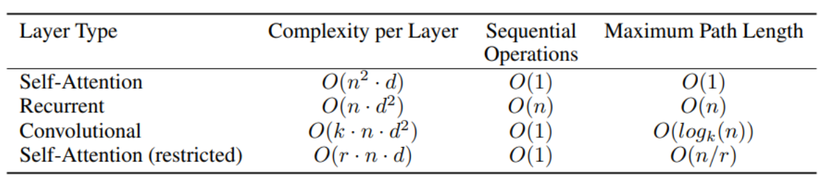
The table compares different embedding configurations in the Transformer. It shows that sinusoidal positional encoding is as effective as learned embeddings, achieving high BLEU scores efficiently. This demonstrates the model's ability to balance simplicity and performance

Slide 21


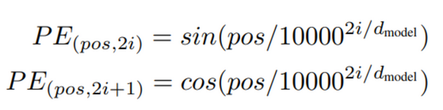

Positional Encoding :
The Problem:
Transformers lack a natural mechanism to understand word order, unlike RNNs. Without positional encoding, the model wouldn't differentiate between:
"The cat sat on the mat."
"The mat sat on the cat."
The Solution: Positional Encoding
Positional encoding adds word order information to embeddings using mathematical functions. It helps the Transformer understand the sequence of words in a sentence
How It Works:
Each word is assigned a unique positional encoding based on its position in the sentence.
Sine (sin⁡\sinsin) and Cosine (cos⁡\coscos) functions are used for this encoding.
o
Why It Matters:
Adds word order information for better understanding of sequences.
Allows generalization to longer sequences beyond those seen during training.

Slide 22

Why Self Attention
To know why preferring self-attention over RNN (Recurrent Neural Network Layers) and CNN (Convolutional Neural Network Layers), the comparison based on three factors:
Total Computational Complexity Per Layer
Parallelizability
Path Length Between Long – Range Dependencies

Slide 23


Total computational complexity per layer
What is computational complexity?
It measures how much computation a model layer requires as a function of:
a. sequence length (n): the number of elements (e.g. words) in the input sequence.
b. representation dimensionality (d): the size of the feature vector used to represent each element.
Having:
Self Attention Complexity: connect every position in the input sequence to every other position.
RNN Complexity: Process the sequence step by step, at each step the model updates a hidden state of size d and computes output.
CNN Complexity: Apply convolutional filters (kernels)of size k across the sequence, each filter processes k elements at a time, sliding across all n positions.

Slide 24


Parallelizability
It measures how much computation can be performed at the same time using modern hardware like GPUs or TPUs
(The minimum number of sequential operations)
RNN: Process sequences one step at a time (sequential) each step depends on the result of the previous step.
Self Attention & CNN: Process all positions in the sequence simultaneously, making them highly parallelizable.

Slide 25
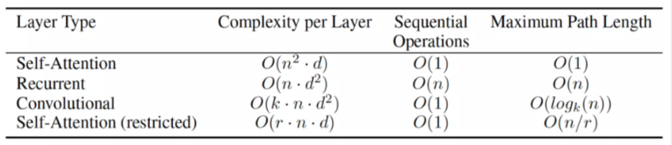
Path Length between Long – Range Dependencies
A path length is measures the number of computational steps (layers or operations) requires for a signal to travel from one position to another.
Why it matters?
Long length make it harder for a model to learn relationships between distant positions especially in long sequences.

Slide 26

Why Self Attention is Better ?
Efficiency: Faster for short sequences (n<d)
Generalization: Capture long range dependencies better than RNN or CNN
Interpretability: Attention weights make it easier to understand what the model is learning
Parallelization: All computations can be done simultaneously

Slide 27
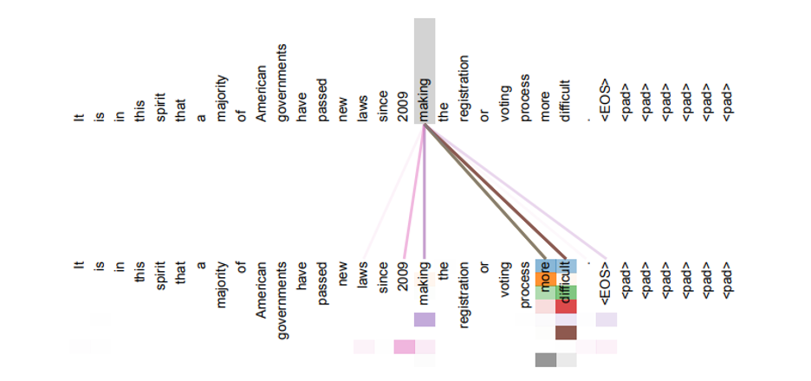
Attention Visualization
Sentence: It is in this spirit that a majority of American governments have passed new laws since 2009 making the registration or voting process more difficult

Slide 28
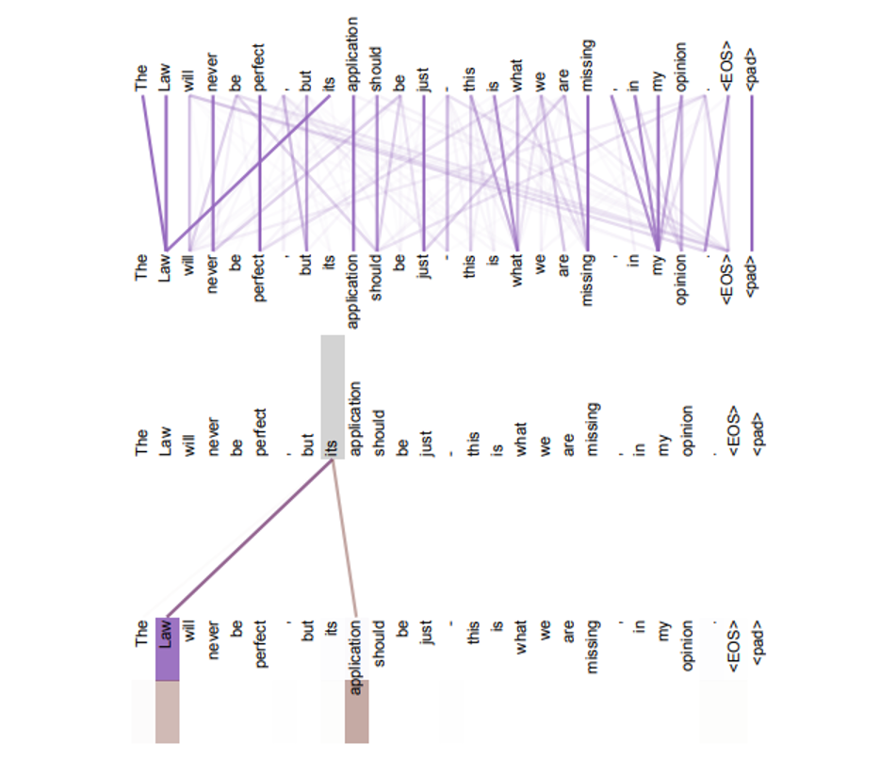
Attention Heads and Anaphora Resolution
Sentence: The law will never be perfect, but its application should be just- this is what we are missing, in my opinion.

Slide 29

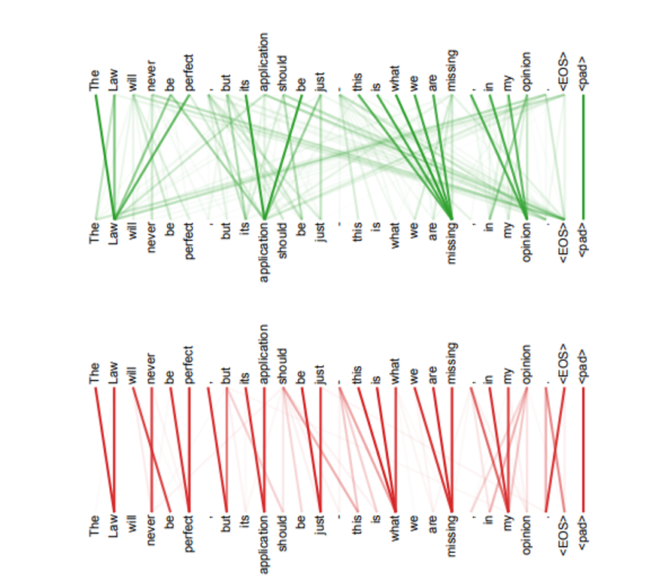
Specialized Attention Heads
Sentence: The law will never be perfect, but its application should be just- this is what we are missing, in my opinion.

Slide 30

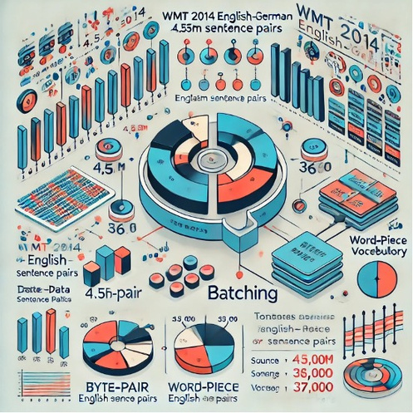

Attention Is All Training
Training data: is a set of data used to train machine learning models, it's the data used to teach the model how to recognize patterns and features in the data.
Here we have an explanation of how to prepare and train machine translation data between English and German using the WMT 2014 English-German dataset.
The authors trained their model on standard machine translation datasets, specifically the WMT 2014 English-German dataset, which consists of approximately 4.5 million sentence pairs.

Slide 31



Specialized Attention Heads
For the English-French translation task, they utilized a much larger dataset containing around 36 million sentences.
This encoding method reduces the vocabulary size by splitting words into smaller segments, which decreases token repetition.
The sentences were processed using byte-pair encoding to create a shared vocabulary of about:
37,000 tokens for English-German
32,000 tokens for English-French
For English-to-German translation, the team used a dataset containing about 4.5M sentence pairs, with sentences encoded using Byte-Pair Encoding (BPE).

Slide 32

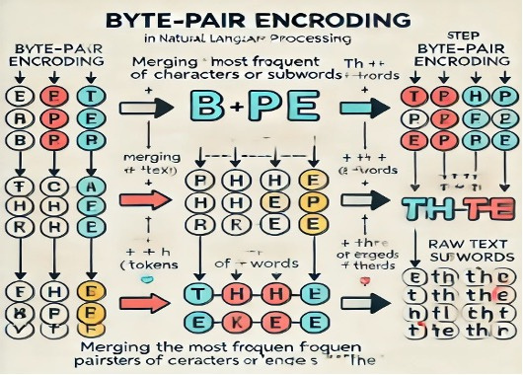
Preprocessing Steps:
Tokenization: Convert sentences into tokens (words or subwords).
Encoding: Use techniques like Byte Pair Encoding (BPE) to create a manageable vocabulary.
Numerical Representation: Transform tokens into numerical vectors for model input.

Slide 33



What’s Batching?
Sentence pairs are grouped by approximate sentence length to ensure consistency in sentence length within each training batch, which makes the training process more efficient
Each batch contains a set number of sequences, which allows the model to process multiple inputs at once, taking advantage of the parallel processing capabilities of GPUs.
In this paper used a method called dynamic batching, which groups sentences based on their lengths
What’s dynamic batching?
Is a technique in machine learning that improves efficiency by grouping similar data samples together for processing. Instead of waiting for a fixed number of samples to fill a batch, t allows processing to start as soon as enough samples are available or after a set time.

Slide 34

Hardware and Schedule
The authors utilized NVIDIA P100 GPUs for training their models, which were high-performance GPUs widely adopted for deep learning applications at the time of the paper's publication.
They trained the model in two different structures: Base Models, & Big models.
Base Models:
Time per training step: 0.4 seconds.
Total steps: 100,000 steps.
Total training time: 12 hours.
Big Models:
Time per training step: 1.0 second.
Total steps: 300,000 steps.
Total training time: 3.5 days.

Slide 35
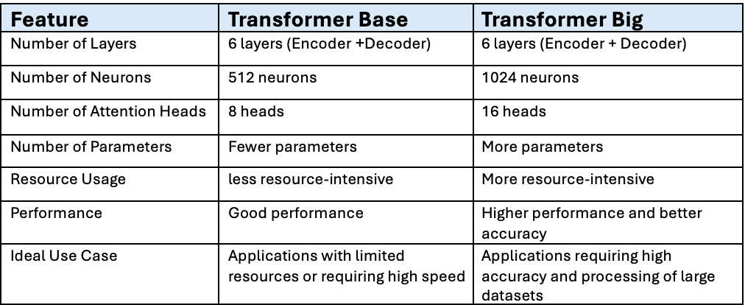
What is the different between Transformer Base & Transformer Big:

Slide 36
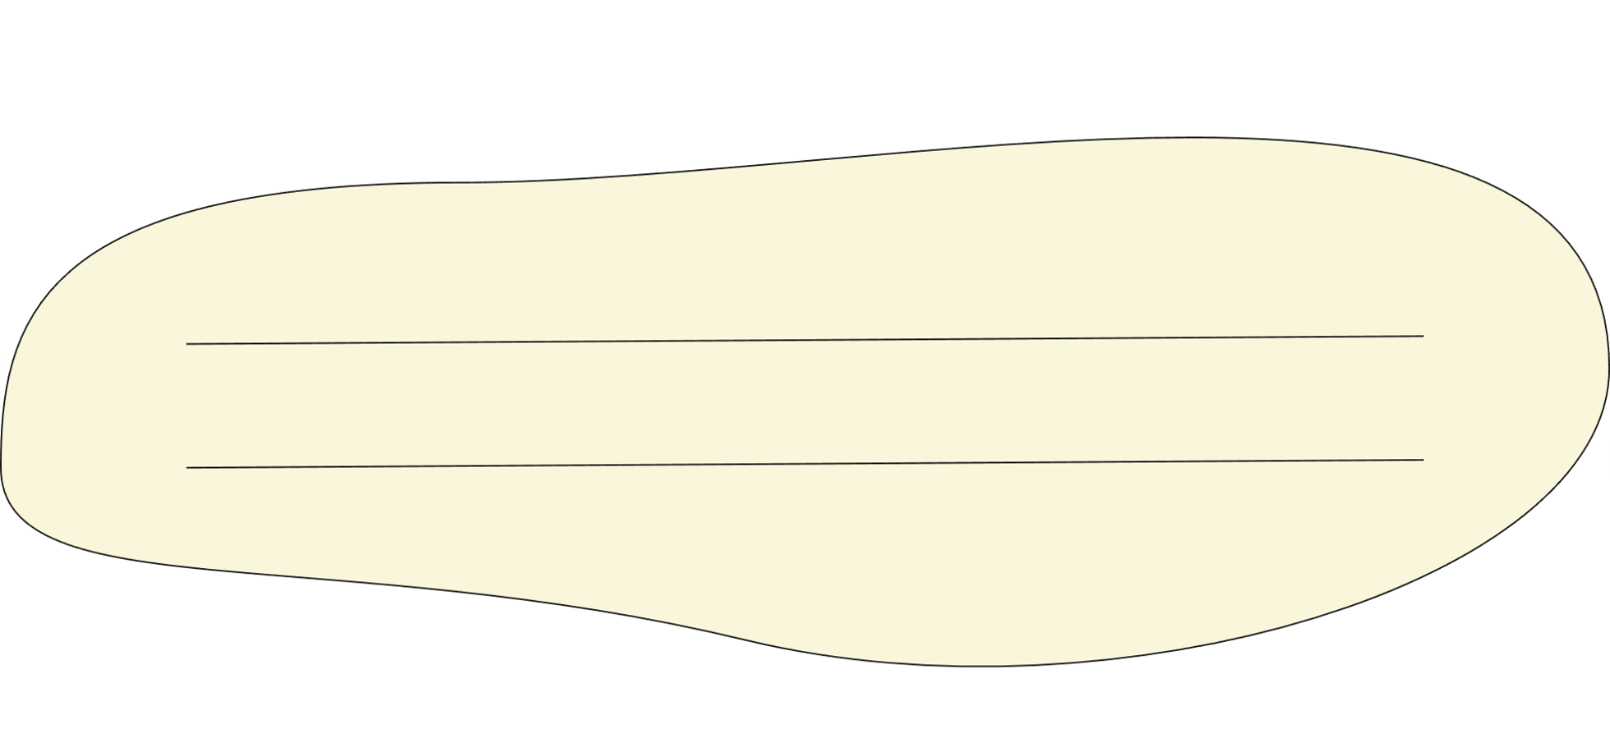
Optimizer
Optimizer is a tool used in machine learning to improve a model's performance by adjusting its internal parameters (weights and biases). During training, it works to reduce the error (loss) between the model's predictions and actual results by iteratively modifying these parameters.
Essentially, the optimizer guides the learning process, ensuring the model gets closer to an optimal solution step by step.
The model uses the Adam optimizer with custom learning rate scheduling
What’s ADAM optimizer?
The Adam optimizer (short for Adaptive Moment Estimation) is a popular algorithm used for updating weights in models during training.
It is designed to be fast and efficient, especially when dealing with large datasets or complex models.

Slide 37
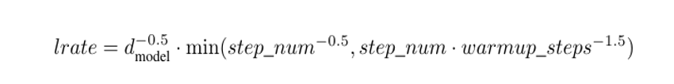

Learning Rate Scheduling
That changes the learning rate dynamically during training to achieve better result
The formula for learning rate:
Hyperparameters:
β₁ = 0.9: Controls the momentum for the gradient.
β₂ = 0.98: Controls the momentum for the squared gradients.
ϵ = 10⁻⁹: A small value to prevent division by zero.
Warmup Phase: The learning rate increases linearly during the first few steps (warmup_steps = 4000).
Decay Phase: After the warmup phase, the learning rate decreases proportionally to the inverse square root of the step number.
Gradually increasing the learning rate at the start helps the model begin learning efficiently; while gradually reducing it later stabilizes the training.

Slide 38

Regularization Techniques
explore two essential regularization techniques used in training deep learning models: Dropout, Label Smoothing
The benefits:
Dropout :
Dropout is a regularization technique used during training to prevent overfitting in neural networks. It works by randomly ignoring a subset of neurons in each training iteration, meaning they do not contribute to the model's forward pass or backpropagation. This forces the model to learn more robust features and reduces reliance on specific neurons, leading to better generalization to new data. Dropout is particularly effective in deep learning models, helping them perform well on unseen data.
Reduces overfitting (where the model memorizes training data but
performs poorly on new data).
Enhances generalization to improve performance on unseen datasets.

Slide 39
The dropout rate used in the model is set at 0.1, meaning 10% of the neurons are randomly "dropped" or ignored during each training step, helping the model to focus on learning more robust features.
Label Smoothing
A regularization technique that adjusts the target labels to be "smoother" instead of being strictly one-hot encoded.
label smoothing can slightly hurt the perplexity (a measure of uncertainty or surprise in the model’s predictions) because the model is less confident in its predictions
The Benefits:
Produces better-calibrated probabilities.
Improves generalization and overall accuracy.

Slide 40


BLEU Score :
A metric used to evaluate the quality of machine-translated text by comparing it with reference translations created by humans.
BLEU (Bilingual Evaluation Understudy) is a metric for evaluating the quality of machine-translated text.
It compares machine-generated translation to one or more reference translations provided by human translators.
BLEU scores range from 0 to 1, where a higher score indicates better translation quality.

Slide 41


Conclusion
Impact:
The Transformer replaces recurrence with attention, making training faster and achieving state- of-the-art results in translation tasks.
Core Benefits:
speed: Parallel computation for efficiency.
Performance: Best BLEU scores in English-to-German and English-to-French.
Flexibility: Generalizes to other tasks like parsing and more.
Broader Influence:
Inspired models like BERT and GPT.
Revolutionized AI for sequence modeling
The Transformer changed how we approach AI, proving that attention mechanisms can achieve unmatched speed, performance, and versatility. Its influence shapes the future of AI

Slide 42

Thanks!

